Slide 1
Clean-Up
6.25.24 version 1.0

Slide 2
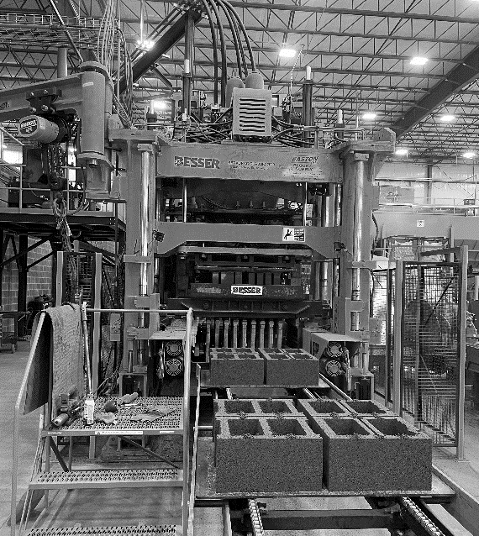
Assumptions and Prerequisite Skills
The computer is on and IntelliBatch 3.0 is open
It is 4:30PM
Must be able to crawl in tight spaces
Supplies Needed
Standard PPE
Air hose with air nozzle and chisel extension
Mallet
Ladder
Shovel
Metal Rake
Broom

Slide 3
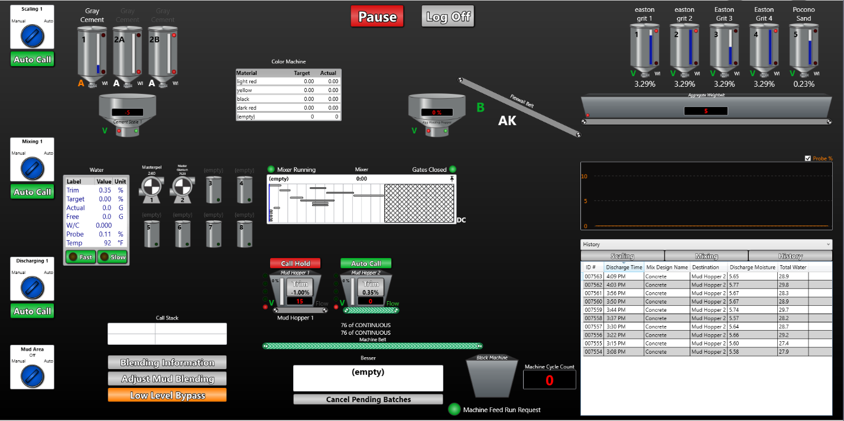
1. Go to IntelliBatch 3.0 and click on the “Cancel Pending Batches” button (Red circle in Figure 1).
Figure 1

Slide 4
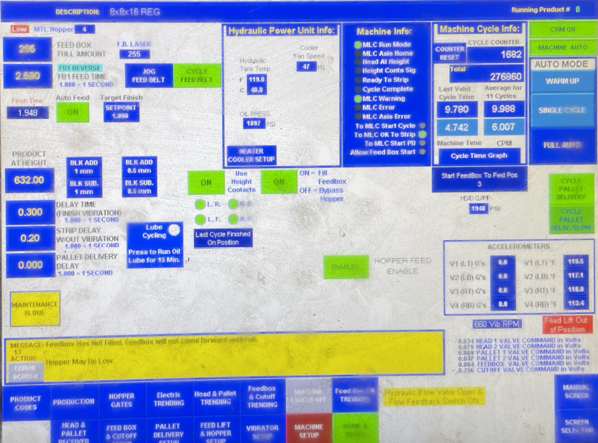
2. Wait until the last batch goes through the Block machine. Once this happens, your HMI should display an error message that says the feedbox is not full (Figure 2).
Figure 2

Slide 5
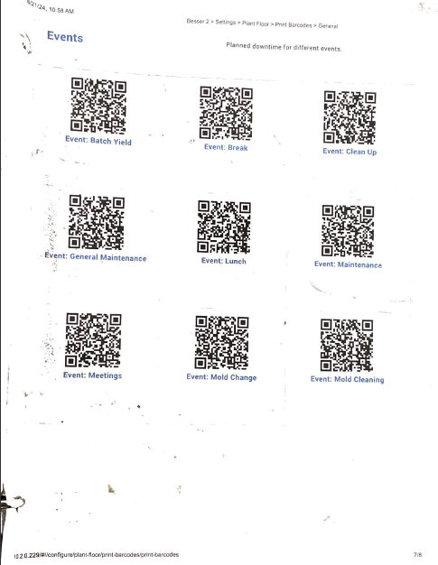
3. Scan “Clean-up” in the QR code booklet (Blue circle in Figure 3).
Figure 3

Slide 6
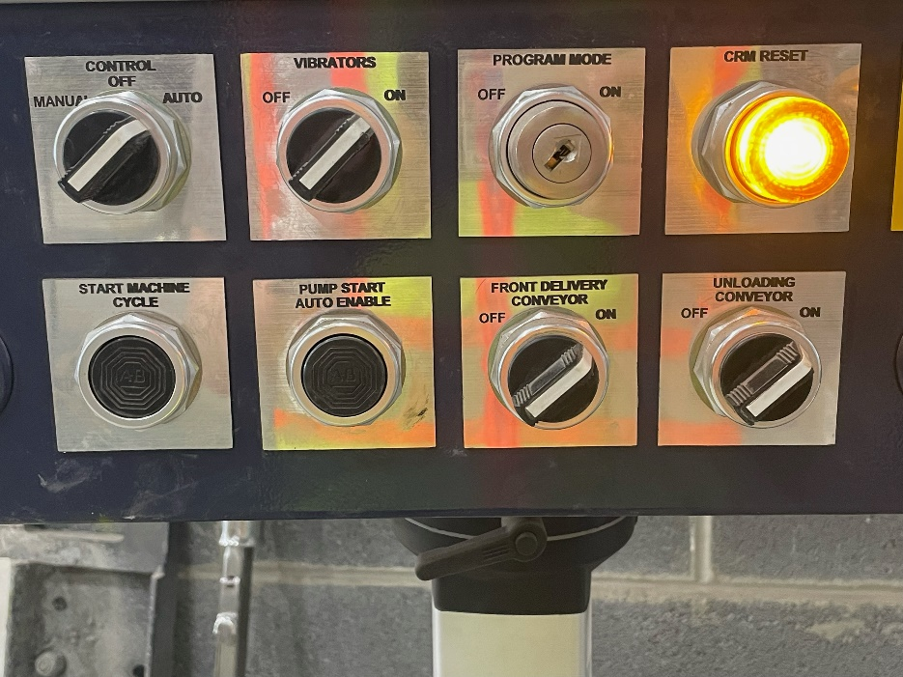
4. Even though the amount of material in the feedbox is lower than the “Feed Box Full Amount”, proceed to the HMI control panel and press “Start Machine Cycle” (Green circle in Figure 4) anyway to get the remaining material out of the feedbox. Examine each pallet and press the button until the newest pallet after cycle is mostly empty. Expect these pallets to be incomplete, and be ready to eject them into the waste hopper in front of the front conveyor.
Figure 4

Slide 7
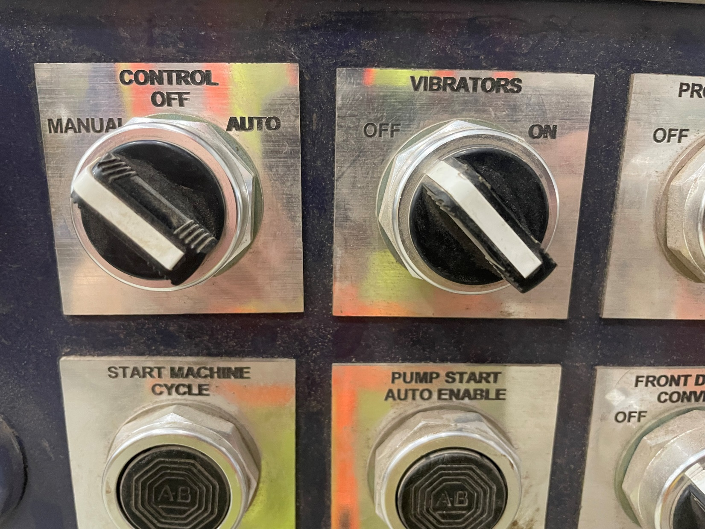
5. Flip the Control switch to “Manual” and turn the vibrators switch to the “Off” position.
Figure 5

Slide 8
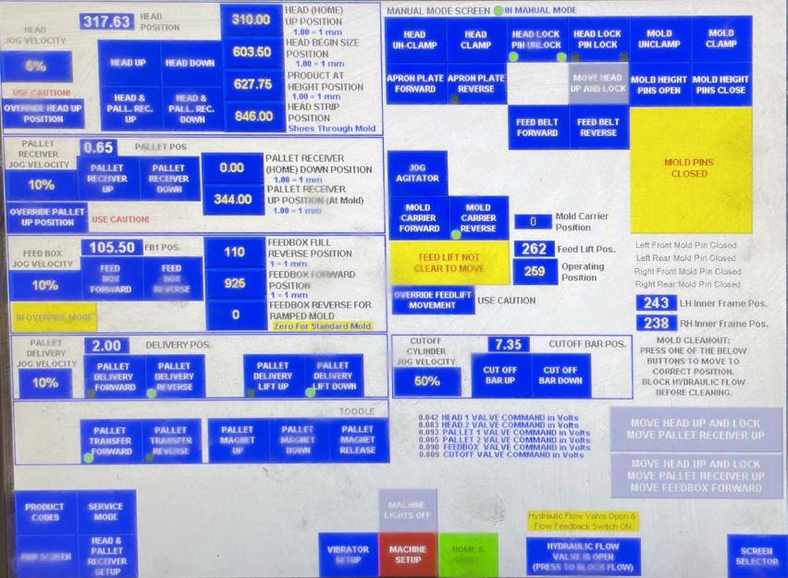
Press and hold the “Head Up” button (Red circle in Figure 6) until the head is no longer moving up. If you want more space to work on the mold, you can hit the “Override Head Up Position” and then press the head-up button until it stops moving up.
Press the “Head Lock” button.
Press and hold the “Feed Box Forward” button (Green circle in Figure 6) until the feedbox is no longer moving forward.
Figure 6

Slide 9
9. Press the “Hydraulic Flow” button (Orange circle in Figure 7) to close the valve, it is now safe to approach the machine.
Figure 7

Slide 10
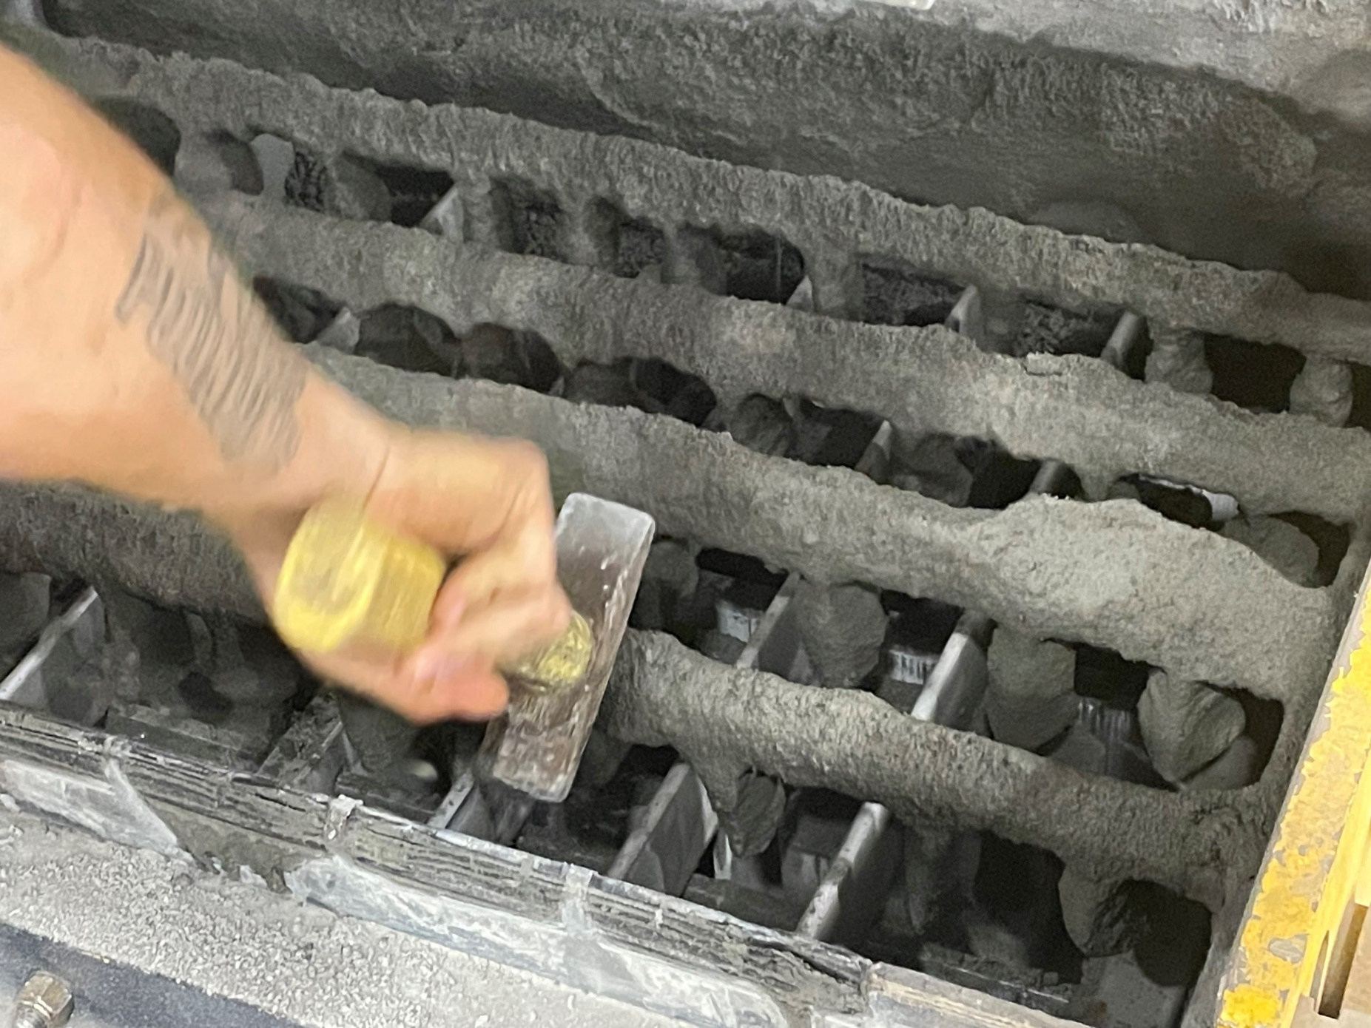
10. Strike the bars of the feedbox with a mallet until all wet material is no longer sticking to the feedbox (Figure 8).
Figure 8

Slide 11
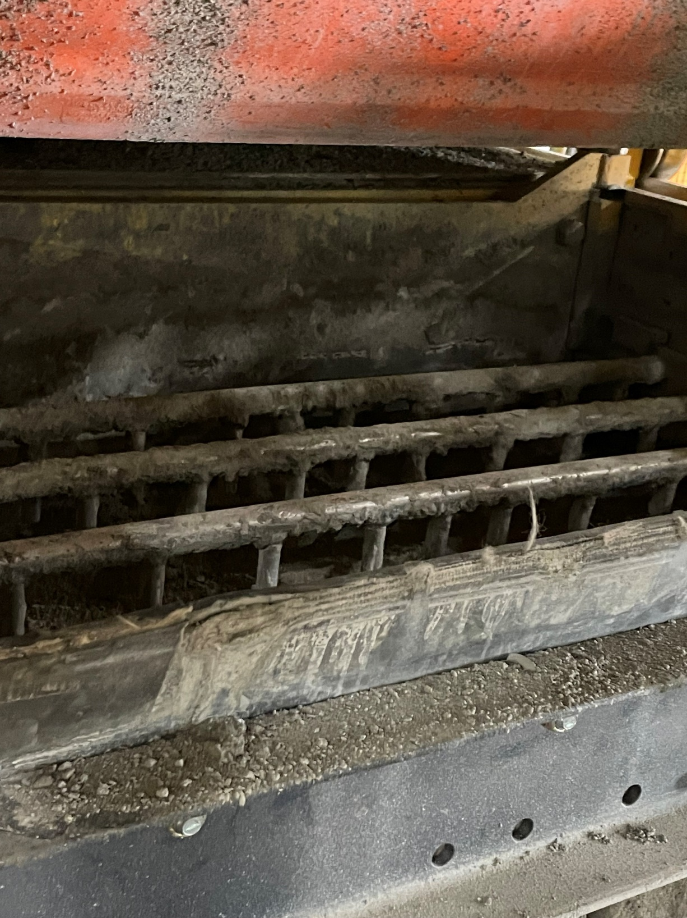
11. To ensure the feedbox can smoothly move back, you must remove any material in the feedbox/mold area with an air hose. Visually assess and ensure that no material may get in the way when the feedbox is being moved back. Figure 9 shows the clean Feedbox back to its original position.
Figure 9

Slide 12
12. Proceed back to the HMI screen. Open the “Hydraulic Flow Valve” (see step #) and press and hold the “Feed Box Reverse” button (Green circle in Figure 10) until the feed box is no longer moving back.
Figure 10

Slide 13
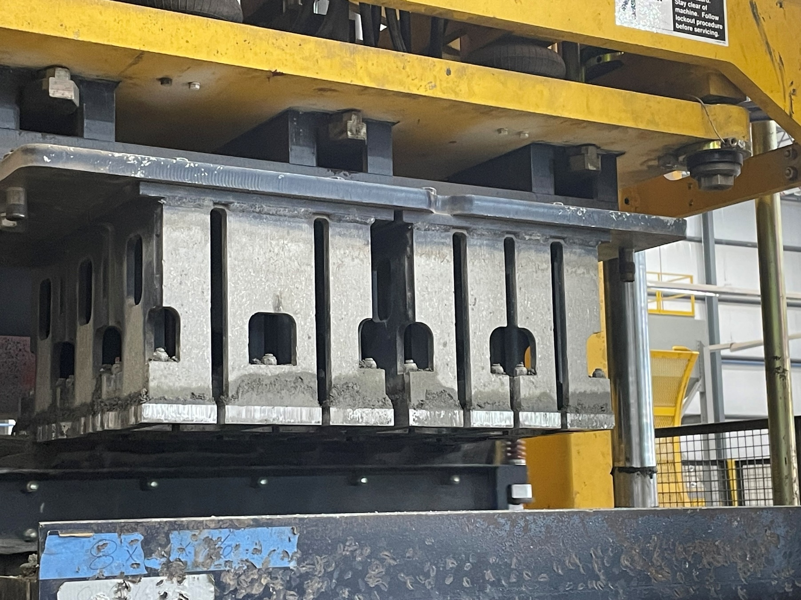
Take a mallet and lightly strike the head of the mold (Figure 11) to remove any potential material stuck inside it. Be careful when striking as too much force can cause dents in the frame.
Take your air hose and attach the chisel extension to it. Grind apart any stuck material on the mold (Figure 12).
Figure 11

Slide 14
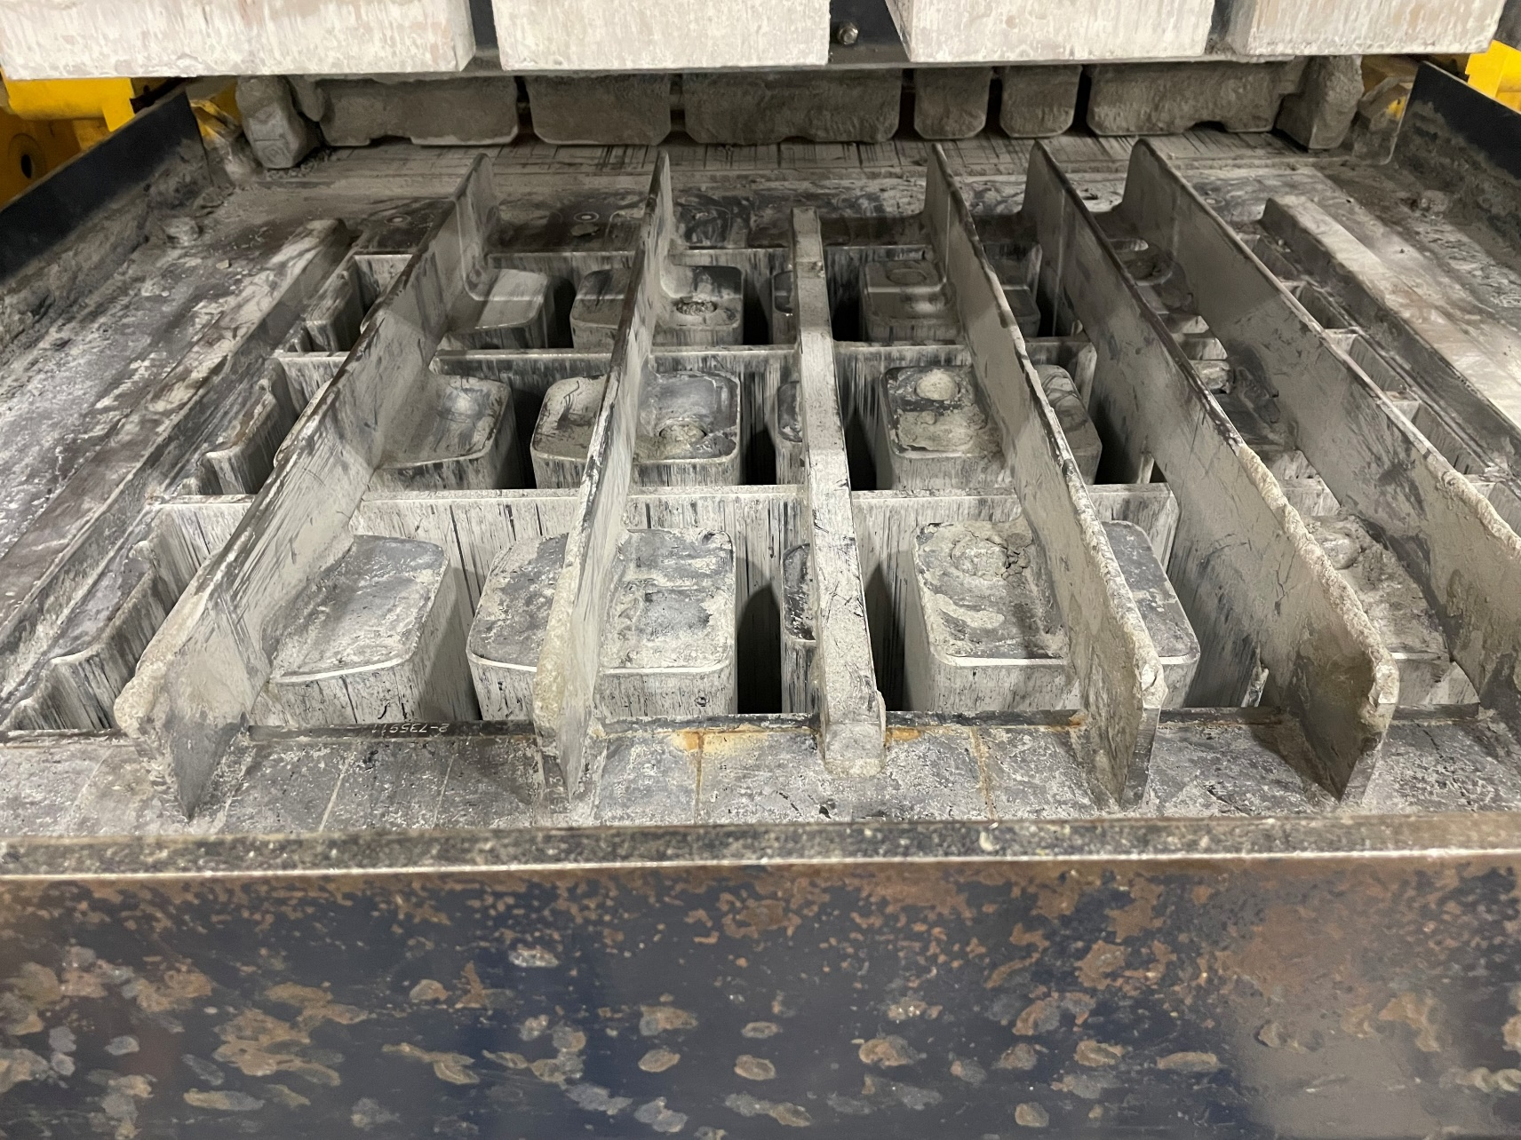
15. Similar to the feedbox, use the air hose with the blower extension to push all of the broken material through the cracks of the mold on the pallet below. Visually assess and make sure there is no dry material that could interfere with tomorrow’s batches. The end result should look similar to Figure 13.
Figure 13

Slide 15
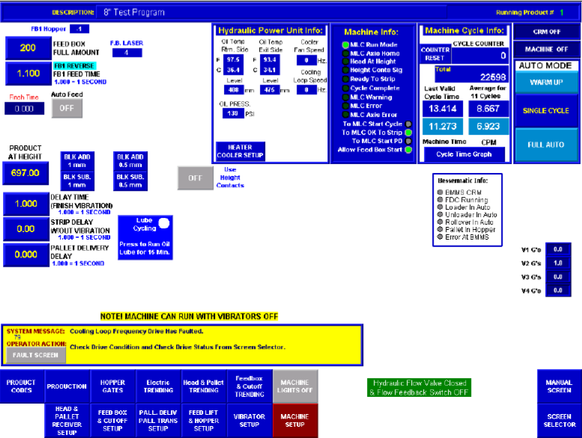
16. Since all material from both the mold and the feedbox have fallen onto the pallet directly below, we would want to dispose this material. Go to the HMI monitor and select “Product Codes” (Red circle in Figure 14).
Figure 14

Slide 16
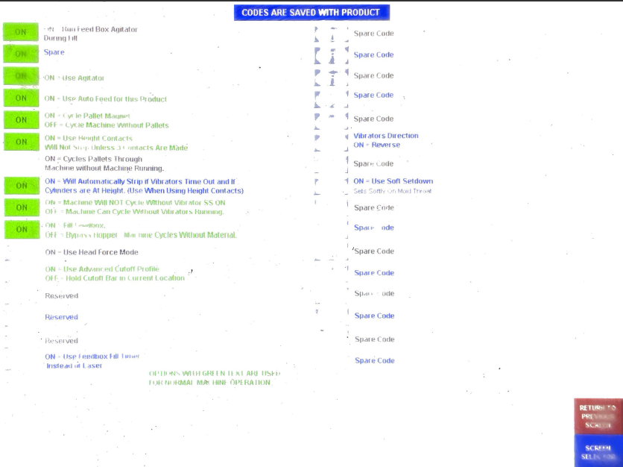
17. Hit the “Off” button on the “Cycle pallets through” option (Red circle in Figure 15), which will turn it to “On”. Let the one pallet enter the front delivery and turn the option back off. Be sure to eject the pallet.
OFF
Figure 15

Slide 17
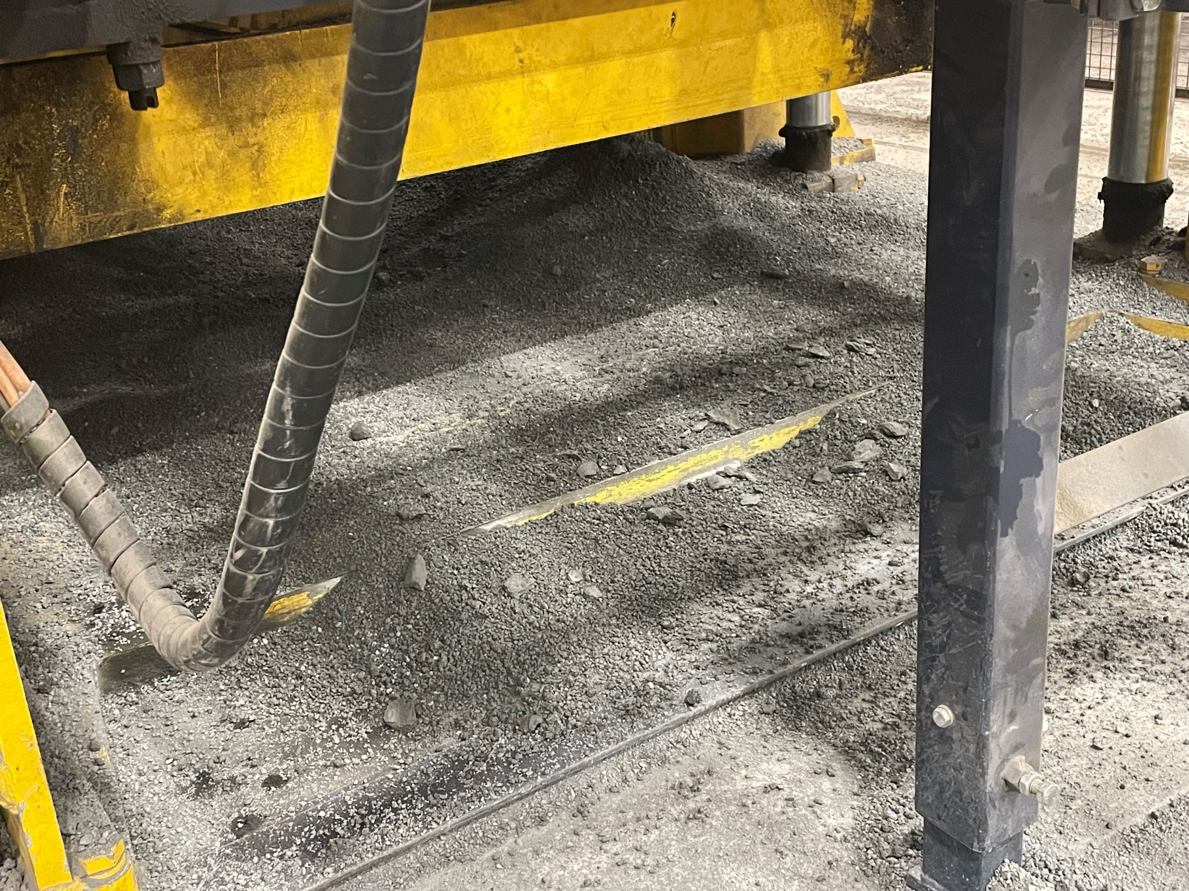
18. Sweep the area in front of the block machine including underneath the mold (Figure 16).
Figure 16

Slide 18
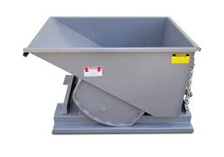
19. Shovel all debris from step 17 into the nearest waste hopper.

Slide 19
20. Repeat step 3. We now must turn off the monitor to open up the gates to the Besser machine.

Slide 20
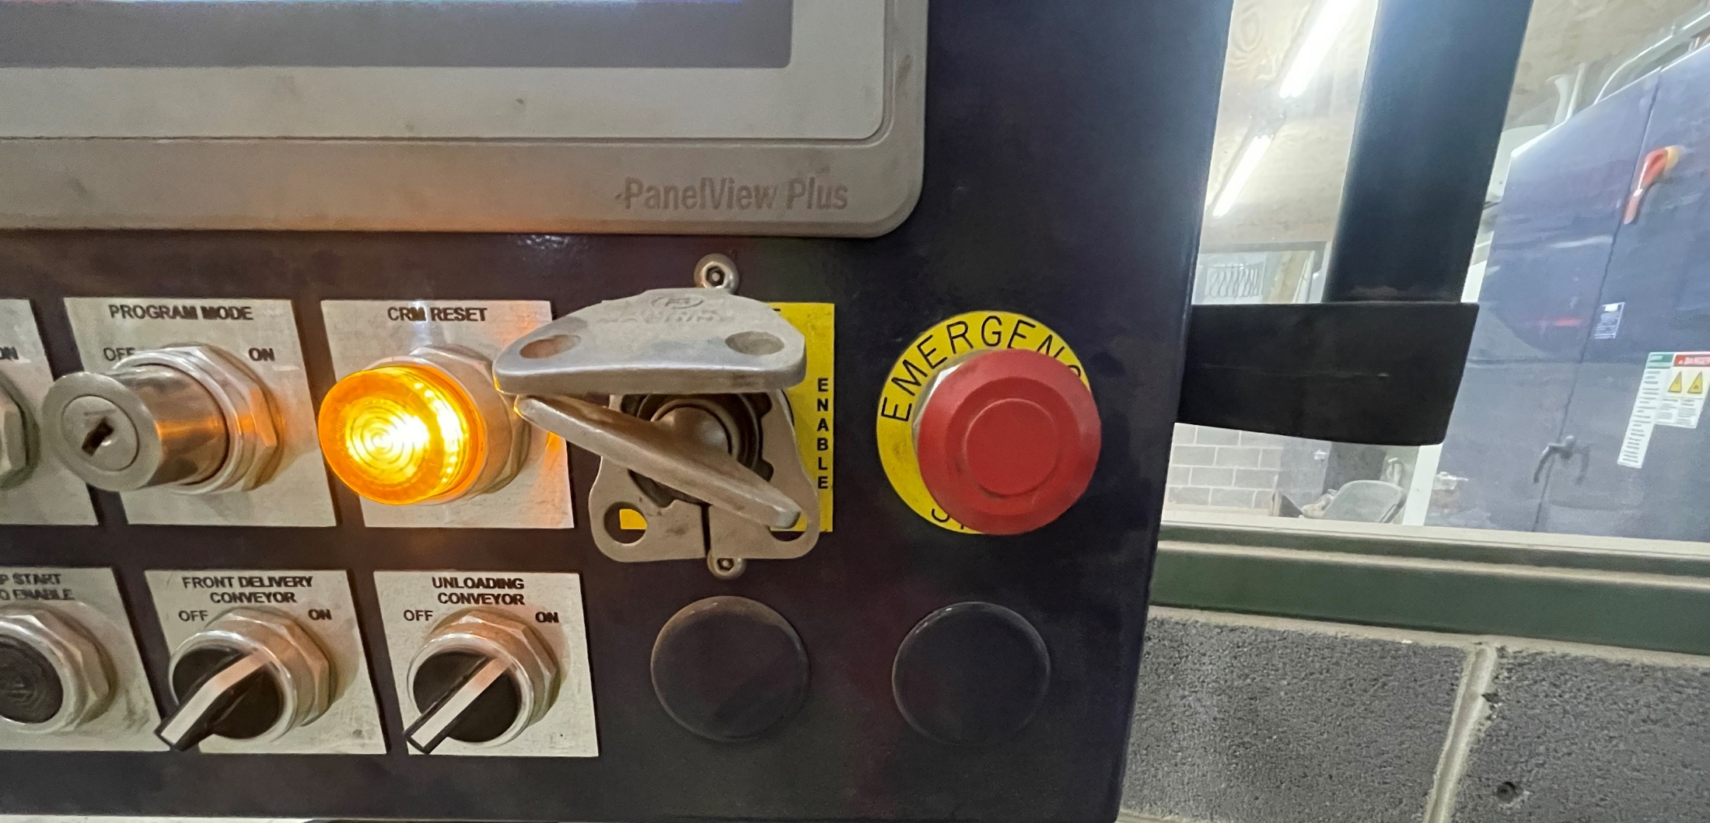
21. Push the “Emergency Stop” button(Green circle in Figure 17) on the HMI control panel and remove the “CRM disable” key (Blue circle in Figure 17).
Figure 17

Slide 21
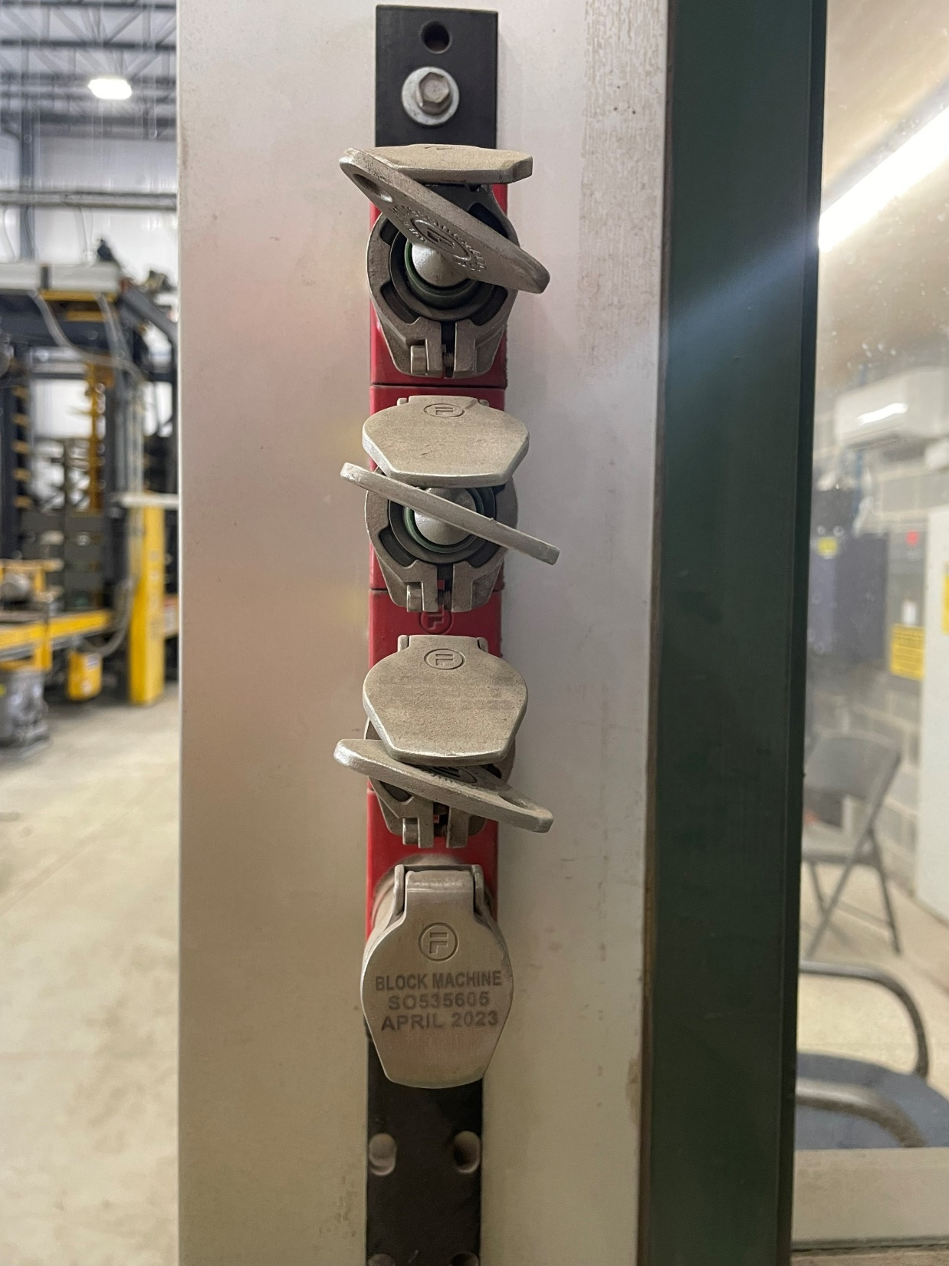
22. Lock up the key in the key rack and pull out any one of the green keys (Green circle in Figure 18).
Figure 18

Slide 22
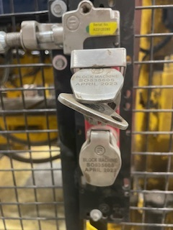
23. Proceed to the gate in front of the Lube Oil reservoir and unlock it using one of the green keys that you selected from step 22 (Figure 19).
Figure 19

Slide 23
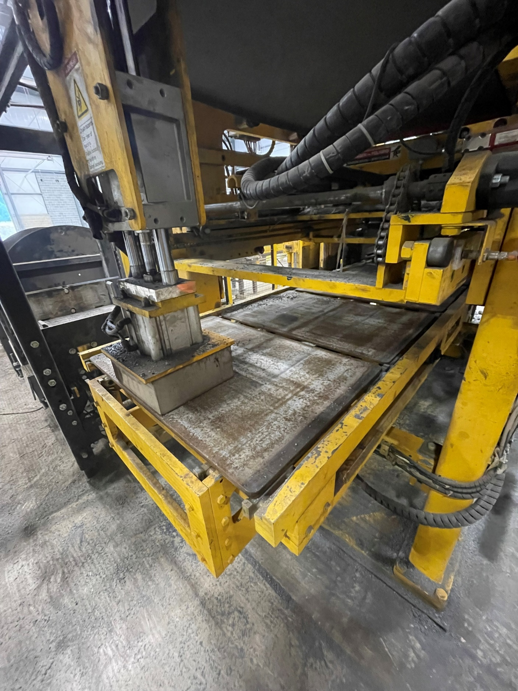
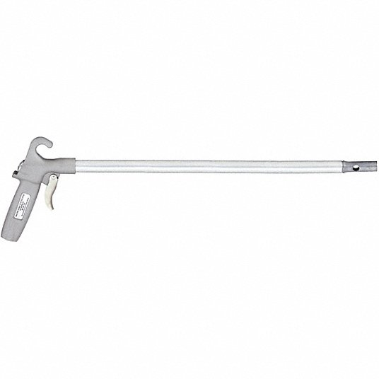
24. Take the air hose with the air nozzle extension and blow all debris off the back of the machine (Figure 20).
Figure 20

Slide 24
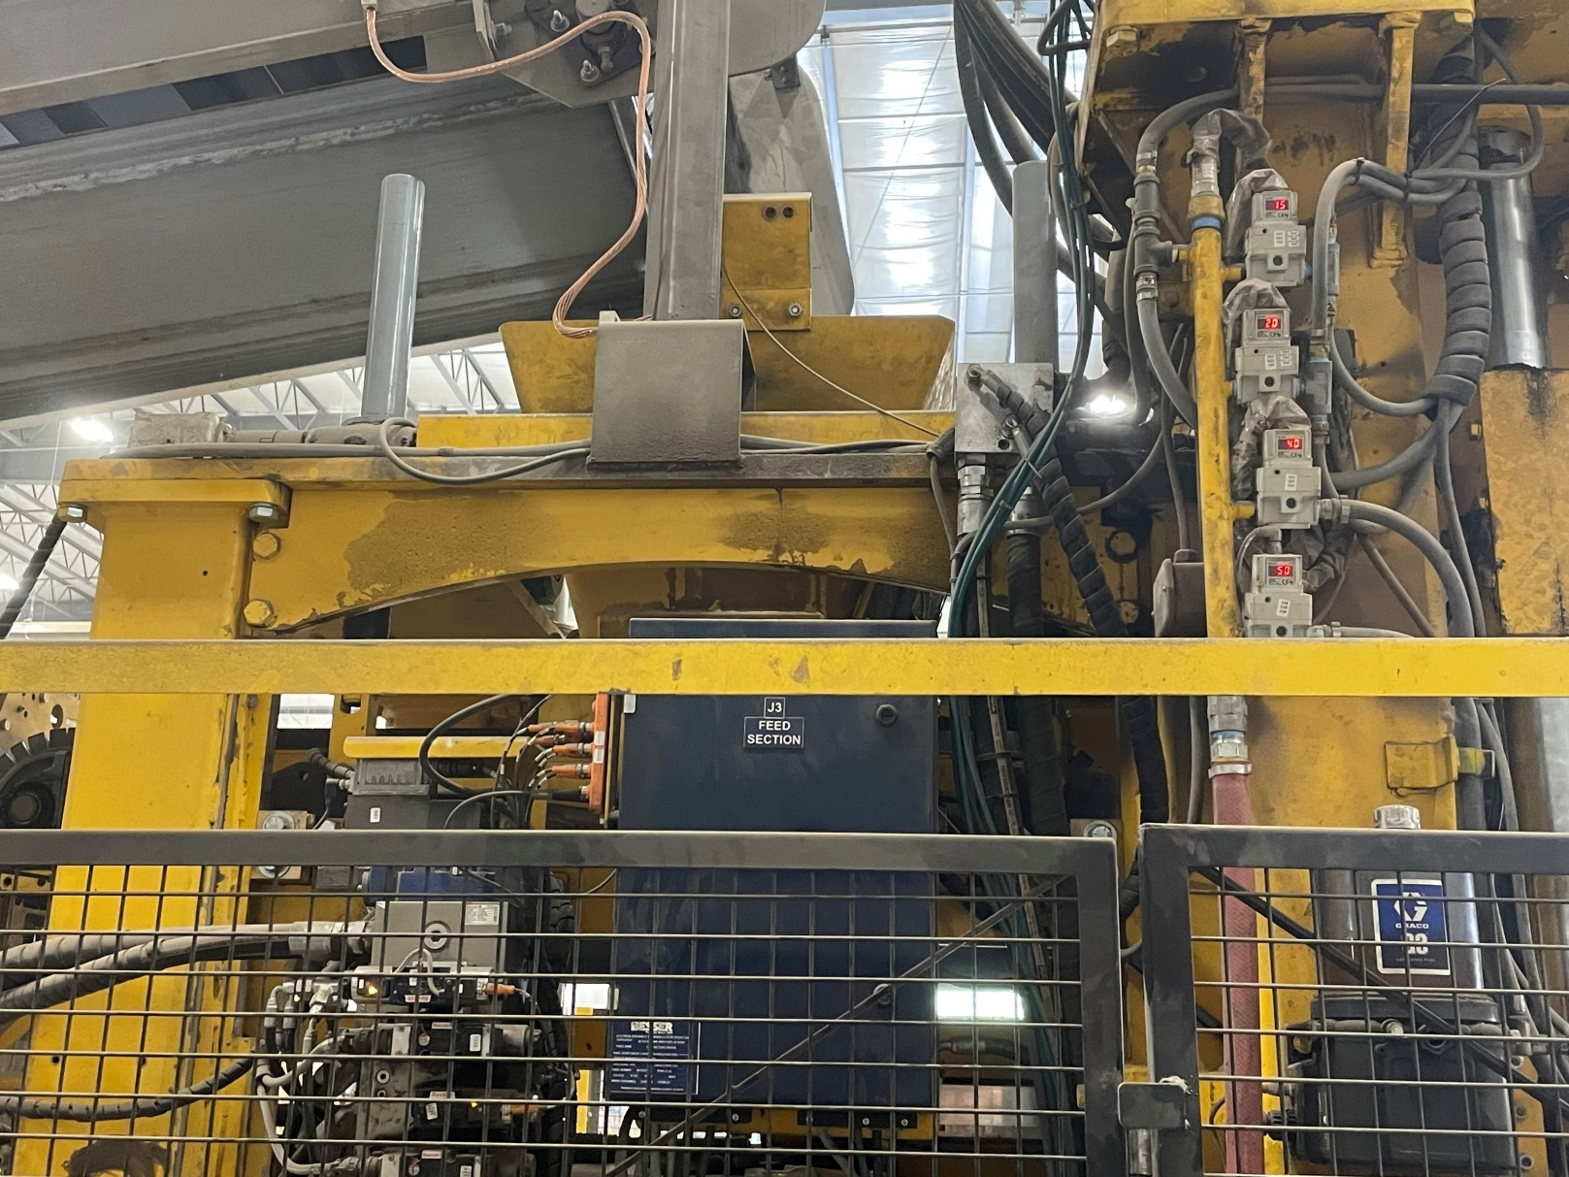
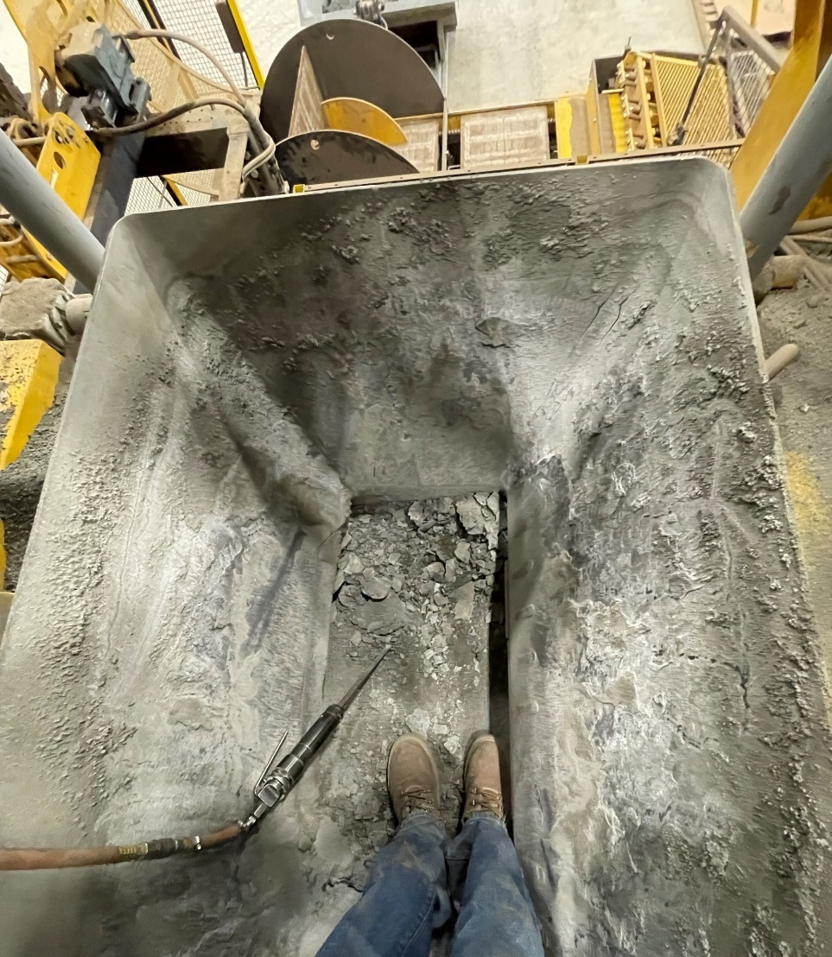
25. Use your ladder to climb up to the Feedbox hopper. Take the air hose with the chisel extension and grind out any stuck material in the hopper (Figure 21).
Figure 21A
Figure 21B

Slide 25
26. Close the gate, lock it, trade keys in the key rack with the red key. Plug the red key back in the HMI control panel, pull out the “Emergency Stop” button, hit the “Pump Start Auto Enable” button (Red circle in Figure 22) and reopen the hydraulic valve.
Figure 22

Slide 26
27. Press and hold the “Feed Belt Reverse” button (Red circle in Figure 23) until material stops falling from the feed belt.
28. Repeat steps 21-23.
Figure 23

Slide 27
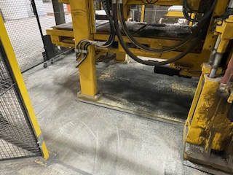
29. Using a metal rake and broom, sweep out all the fallen debris inside the besser area (Figure 24).
Figure 24

Slide 28
30. Shovel all swept debris into the nearest waste hopper.

Slide 29
31. Return the key back in the “CRM disable” slot, but do not start the machine.
32. This completes the clean-up procedure.

